Slide 1
Notes:
Daniel

Slide 2
You do NOT scale crappy code
Notes:
It this case we taling about scaling up

Slide 3
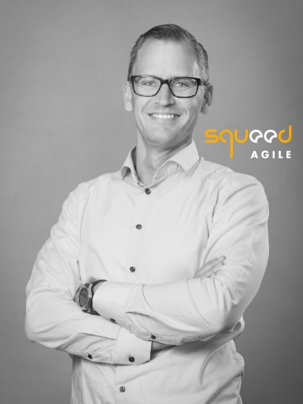
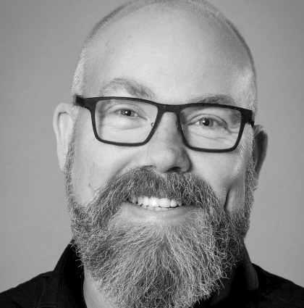
Jonas Jaconelli
Agile Coach
Tom Mårdh
Agile coach
Squeed / Volvo Cars HR
Background: * SW Developer
* Project leader
* Certified Scrum master/SPC
* Teacher/Mentor/Coach
@Ericsson 1999-2015
@Softhouse 2015-2017
@Squeed 2017-
Squeed / Volvo Cars R&D
Background:
* Architect
* Quality/Validation Manager
* Project Manager
* Agile Coach / LeSS Practitioner / SPC
@AstraZeneca 1999-2012
@Softhouse 2012-2017
@Squeed 2017-
“You cannot scale crappy code!”
Today’s industry changes faster and faster and the products need to be delivered faster and faster to the end customers. This put extra requirements on the product quality and is fundamental when working DevOps, which is essential in SAFe framework.
Come and listen to how essential tests is when working using the Scaled Agile Framework.

Slide 4
Complexity
Notes:
Complexity rules

Slide 5
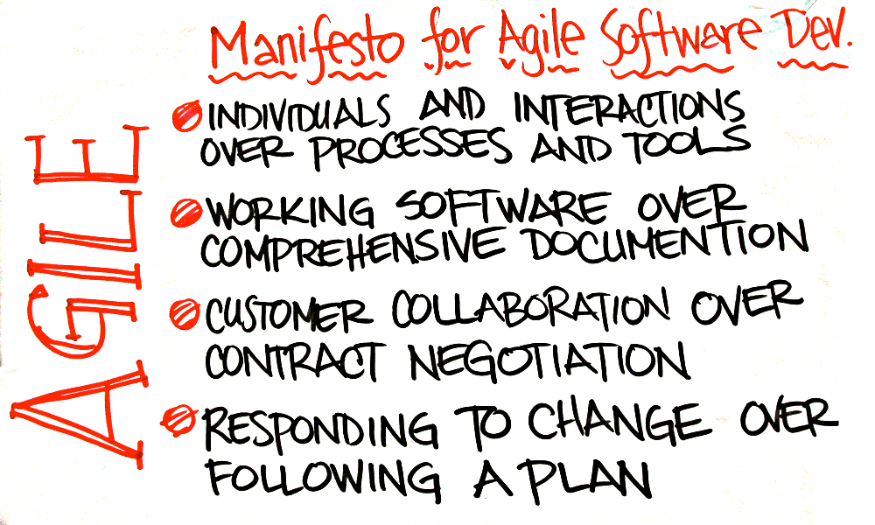
Agile Manifesto
FAST
FEEDABACK

Slide 6
NEXUS
SAFe
Agility @ Scale
Agile@SPOTIFY
Less
DAD
DON’T
...
Notes:
DAD = Descipline agile delivery
Agile at spotify
https://www.youtube.com/watch?v=Du11NQ2SEs4&feature=youtu.be

Slide 7
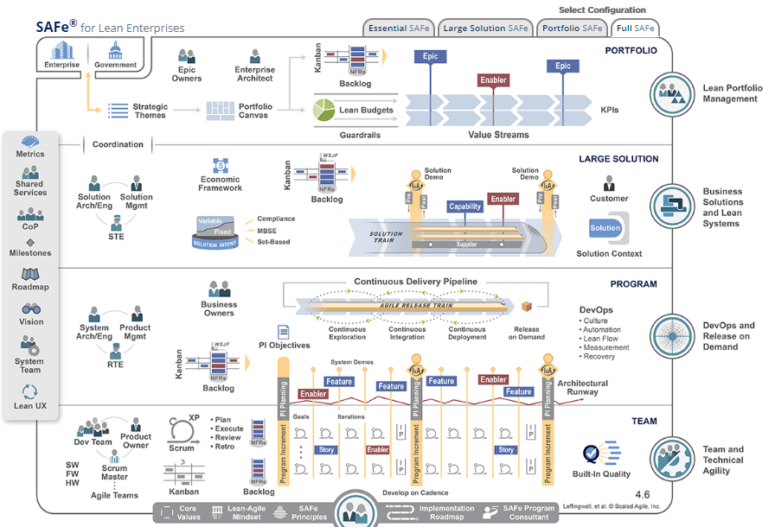
SAFe
https://www.scaledagileframework.com/
Notes:
- Agile Teams
- Program
- System Team
- Solution
- Portfolio
- Competetnce Areas (DevOps and Release on Demand) + Leadership
- Backlogs and SAFe Requirements Model + NFR
- 4 Values (Built in Quality)
- Lean House of SAfe (Flow)
- 9 Principles (build incrementally with fast, integrated Learning Cycles)

Slide 8
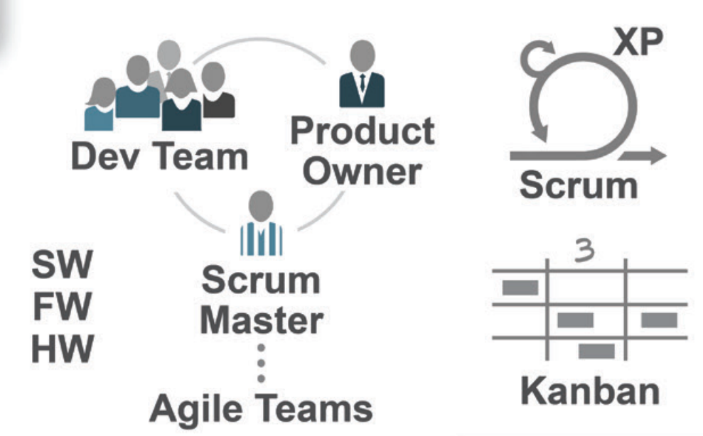
Notes:
- Agile Teams
- Program
- System Team
- Solution
- Portfolio
- Competetnce Areas (DevOps and Release on Demand) + Leadership
- Backlogs and SAFe Requirements Model + NFR
- 4 Values (Built in Quality)
- Lean House of SAfe (Flow)
- 9 Principles (build incrementally with fast, integrated Learning Cycles)

Slide 9
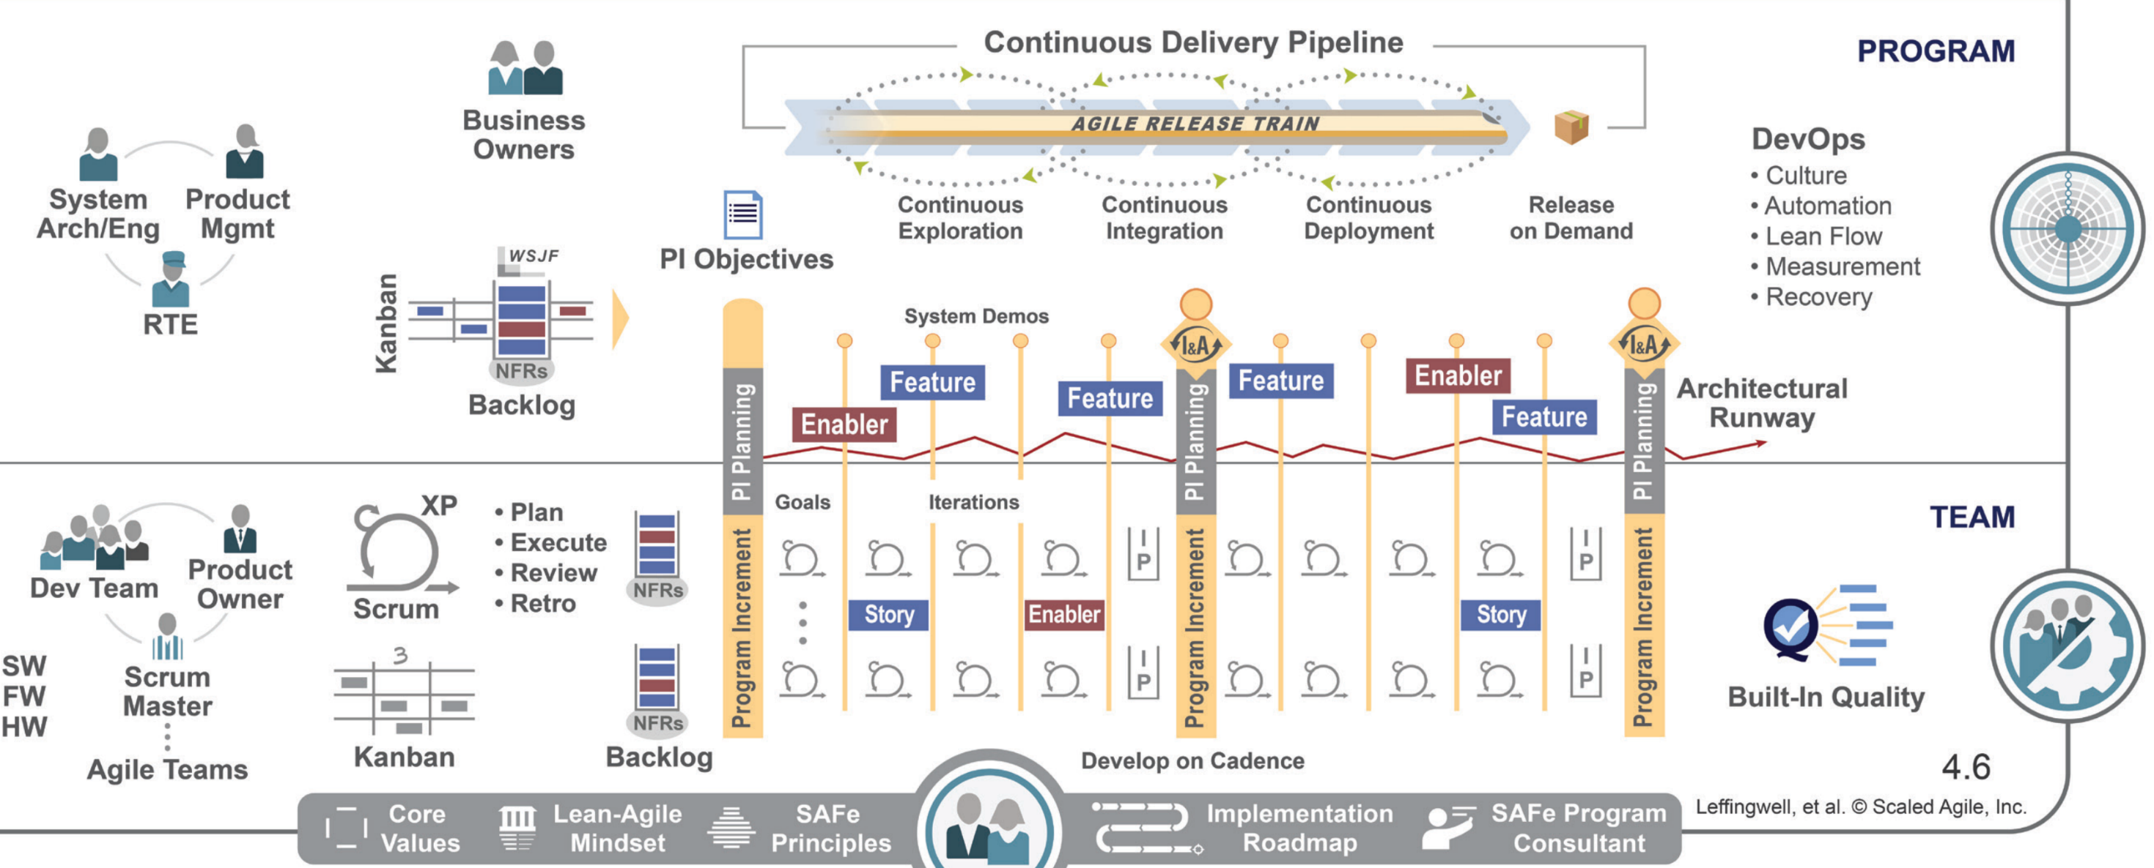
Notes:
- Agile Teams
- Program
- System Team
- Solution
- Portfolio
- Competetnce Areas (DevOps and Release on Demand) + Leadership
- Backlogs and SAFe Requirements Model + NFR
- 4 Values (Built in Quality)
- Lean House of SAfe (Flow)
- 9 Principles (build incrementally with fast, integrated Learning Cycles)

Slide 10
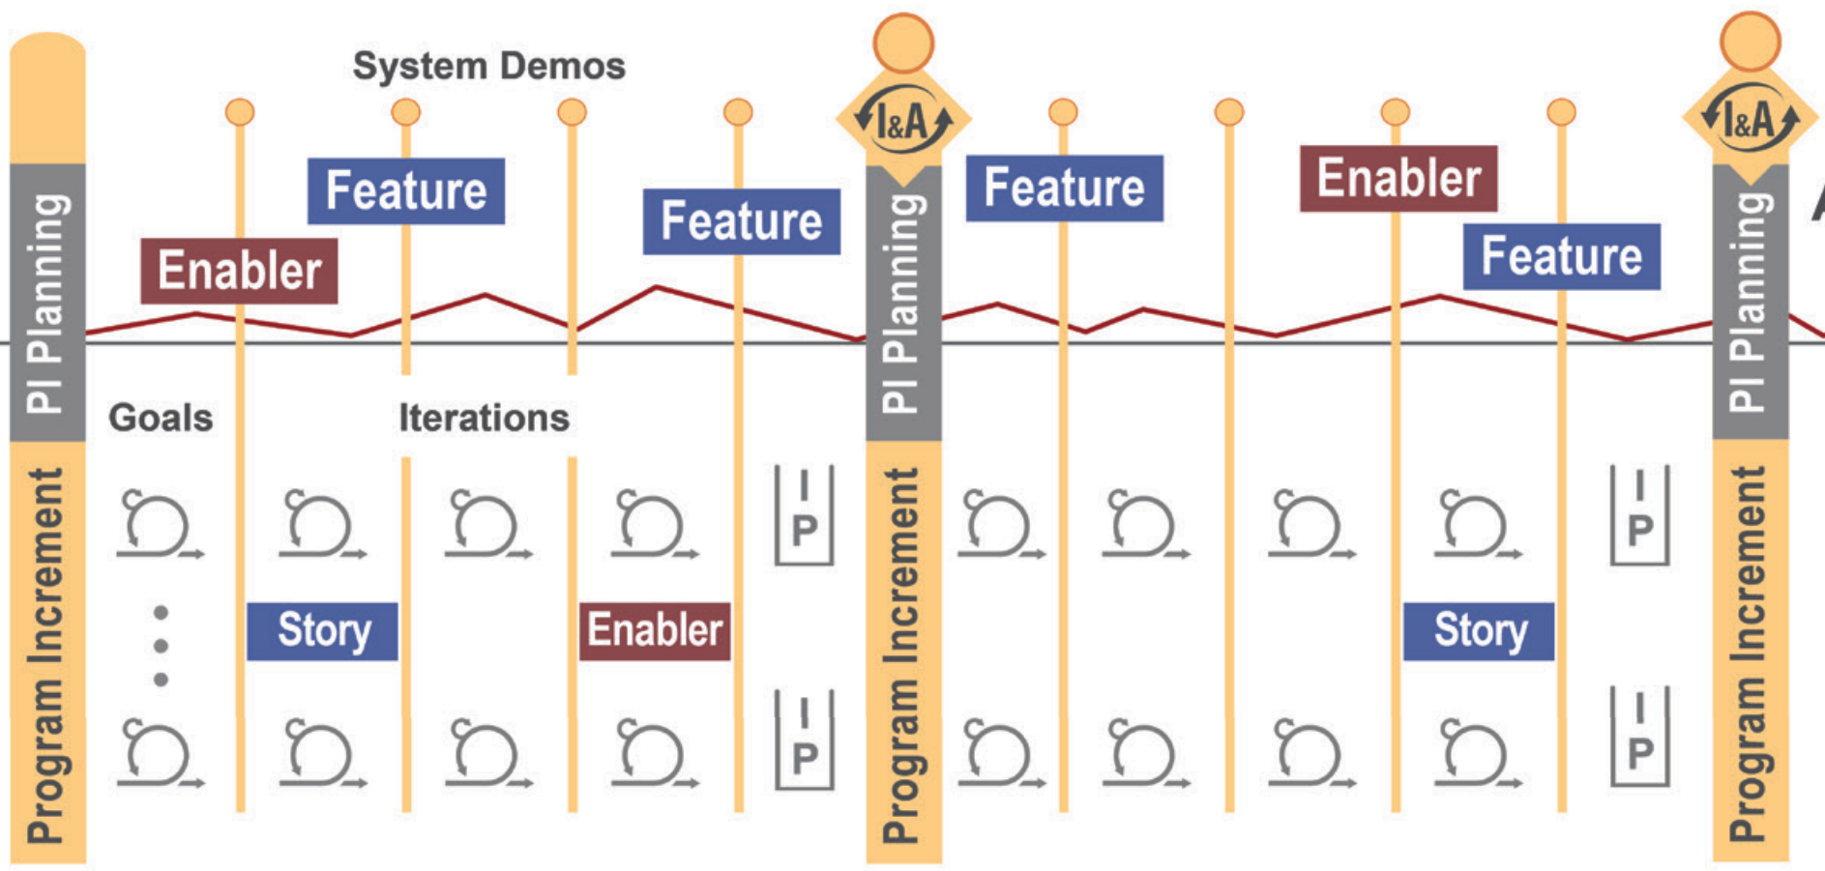
Notes:
- Agile Teams
- Program
- System Team
- Solution
- Portfolio
- Competetnce Areas (DevOps and Release on Demand) + Leadership
- Backlogs and SAFe Requirements Model + NFR
- 4 Values (Built in Quality)
- Lean House of SAfe (Flow)
- 9 Principles (build incrementally with fast, integrated Learning Cycles)

Slide 11
Notes:
- Agile Teams
- Program
- System Team
- Solution
- Portfolio
- Competetnce Areas (DevOps and Release on Demand) + Leadership
- Backlogs and SAFe Requirements Model + NFR
- 4 Values (Built in Quality)
- Lean House of SAfe (Flow)
- 9 Principles (build incrementally with fast, integrated Learning Cycles)

Slide 12
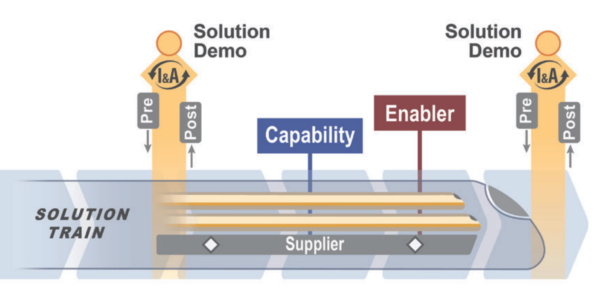
Notes:
- Agile Teams
- Program
- System Team
- Solution
- Portfolio
- Competetnce Areas (DevOps and Release on Demand) + Leadership
- Backlogs and SAFe Requirements Model + NFR
- 4 Values (Built in Quality)
- Lean House of SAfe (Flow)
- 9 Principles (build incrementally with fast, integrated Learning Cycles)

Slide 13
Notes:
- Agile Teams
- Program
- System Team
- Solution
- Portfolio
- Competetnce Areas (DevOps and Release on Demand) + Leadership
- Backlogs and SAFe Requirements Model + NFR
- 4 Values (Built in Quality)
- Lean House of SAfe (Flow)
- 9 Principles (build incrementally with fast, integrated Learning Cycles)

Slide 14
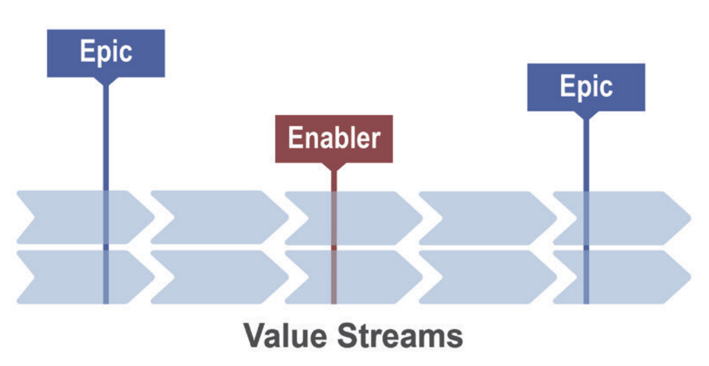
Notes:
- Agile Teams
- Program
- System Team
- Solution
- Portfolio
- Competetnce Areas (DevOps and Release on Demand) + Leadership
- Backlogs and SAFe Requirements Model + NFR
- 4 Values (Built in Quality)
- Lean House of SAfe (Flow)
- 9 Principles (build incrementally with fast, integrated Learning Cycles)

Slide 15
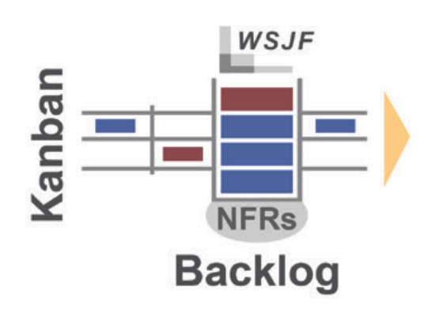
Notes:
- Agile Teams
- Program
- System Team
- Solution
- Portfolio
- Competetnce Areas (DevOps and Release on Demand) + Leadership
- Backlogs and SAFe Requirements Model + NFR
- 4 Values (Built in Quality)
- Lean House of SAfe (Flow)
- 9 Principles (build incrementally with fast, integrated Learning Cycles)

Slide 16
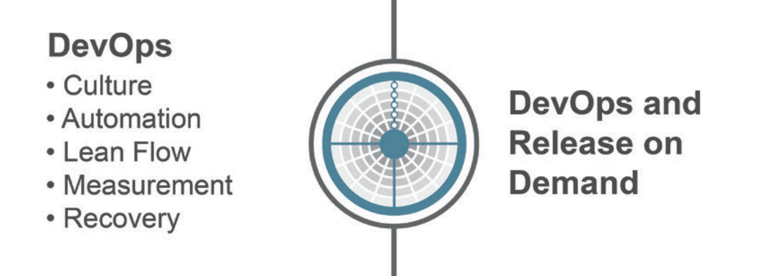
Notes:
- Agile Teams
- Program
- System Team
- Solution
- Portfolio
- Competetnce Areas (DevOps and Release on Demand) + Leadership
- Backlogs and SAFe Requirements Model + NFR
- 4 Values (Built in Quality)
- Lean House of SAfe (Flow)
- 9 Principles (build incrementally with fast, integrated Learning Cycles)

Slide 17
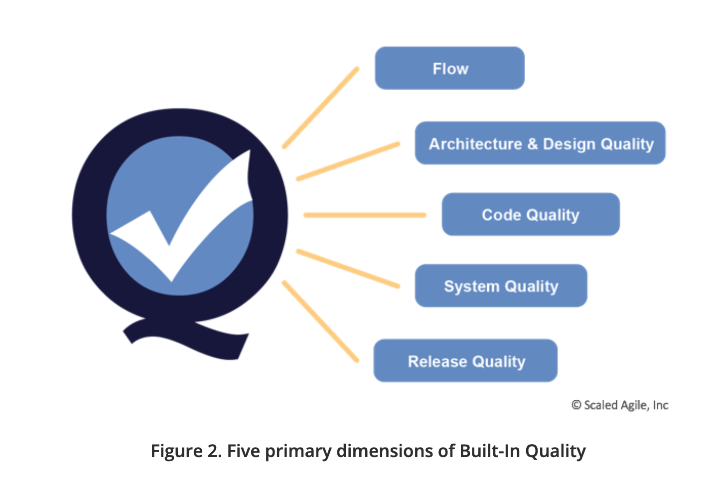
4 SAFe Core Values
Alignment
Built-in Quality
Transparence
Program Execution

Slide 19
9 SAFe Principles
Take an economic view
Apply systems thinking
Assume variability; preserve options
Build incrementally with fast, integrated learning cycles
Base milestones on objective evaluation of working systems
Visualize and limit WIP, reduce batch sizes, and manage queue lengths
Apply cadence, synchronize with cross-domain planning
Unlock the intrinsic motivation of knowledge workers
Decentralize decision-making

Slide 20
Notes:
- Agile Teams
- Program
- System Team
- Solution
- Portfolio
- Competetnce Areas (DevOps and Release on Demand) + Leadership
- Backlogs and SAFe Requirements Model + NFR
- 4 Values (Built in Quality)
- Lean House of SAfe (Flow)
- 9 Principles (build incrementally with fast, integrated Learning Cycles)

Slide 21
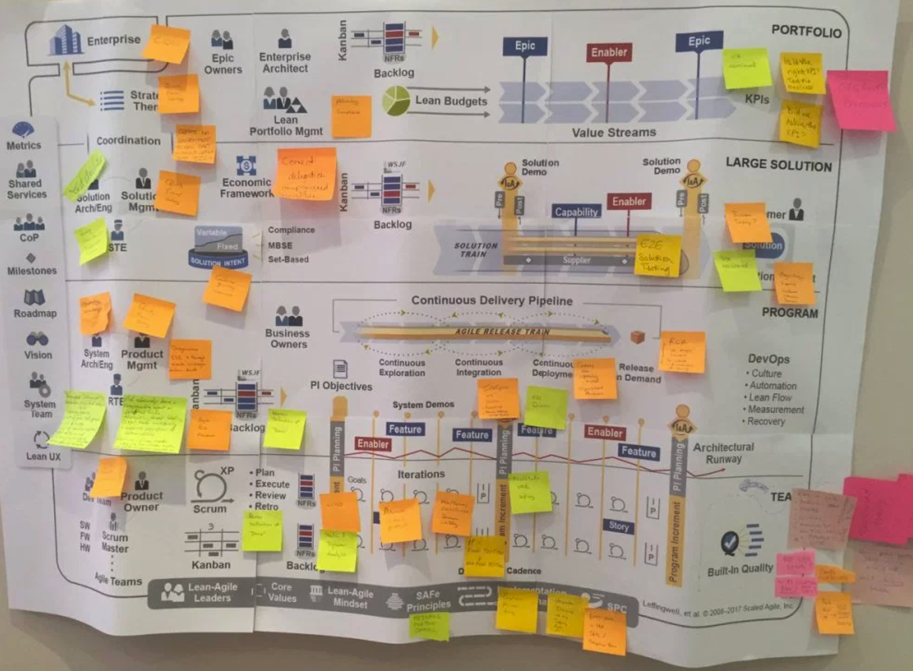
trge
Testing and Quality in the Scaled Agile Framework for Lean Enterprises (e-Book)
https://huddle.eurostarsoftwaretesting.com/resources/agile-testing/testing-quality-scaled-agile-framework-lean-enterprises/

Slide 22
ARTs continuously deliver value
Notes:
Key Message:
The Continuous Delivery Pipeline represents the ability to deliver new functionality to users far more frequently than current processes are able to. For some software systems, ‘continuous’ means daily releases or even releasing multiple times per day. For others, continuous may mean weekly or monthly.
For large and complex systems, releasing the solution avoid taking an ‘all-or-nothing’ approach. Consider a satellite system comprised of the satellite, the ground station, and a web farm to feed the acquired satellite data to end users. Some elements may be released continuously—perhaps the web farm functionality. Others, like the hardware components of the satellite itself, may only be released every launch cycle.
So, in a sense, continuous delivery means what you need it to mean—as long as the goal is to deliver far more frequently than now. In our satellite example, the more capability that gets moved to software, the more continuous the delivery can become, as those elements can then be decoupled from physical launch constraints. In all cases, the goal should be clear: more frequent delivery of value to the end user.
Read more at: http://www.scaledagileframework.com/continuous-delivery-pipeline/

Slide 23
Traditional testing (V-Model) delays feedback
Write Feature
Test Feature
Write Story
Test Story
Write Code
Test Code
Notes:
Trainer Guidance:
This is the traditional V Model. The tests for code, stories, and features are written after the implementation is complete. Requirements may be interpreted differently by the developer and tester, thus causing defects due to ambiguous requirements.

Slide 24
Shift testing left for fast and continuous feedback
Shift Testing Left
FEATURE TESTS
(BDD)
Test Feature
Write Feature
… always testing…
STORY TESTS
(BDD)
Write Story
Test Story
… always testing…
CODE TESTS
(TDD)
Write Code
Test Code
… always testing…
Notes:
Trainer Guidance:
Shifting the testing left means that the tests for features, stories, and code components are written prior to implementation. The tests for features can be translated into tests for stories and the story tests can be translated into tests for code components. The tests at higher level can be run as soon as the lower levels are complete.

Slide 25
XYZ ( - Continuously improves -)
System tests
Win7/Win8/Win10
Weekly tests
Build client
Client tests
Nightly tests
Exploratory testing
Nightly testss
Build Product
Nightly testss
Code
Static code analyze
Build server
Sever tests
Hourly tests
Test
Build
Code
Notes:
Team 99 : All people involved ended VOT

Slide 26
Test the WHOLE system!
https://imgur.com/Na9jGYR

